Slide 1

2023/11/1
Erik Hazel Vilchis

Slide 2
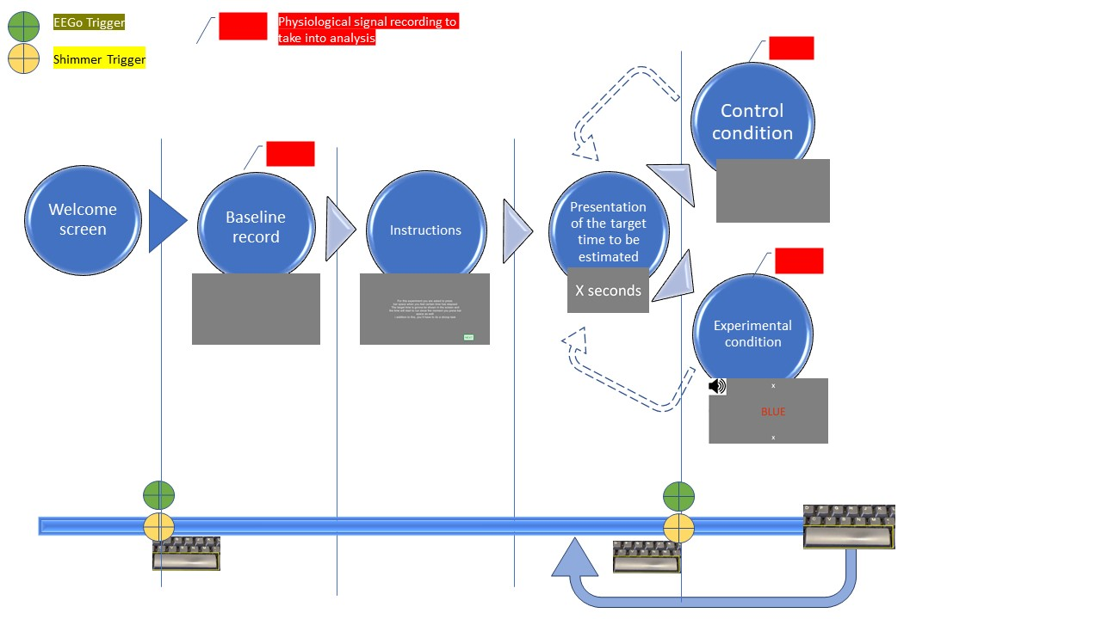
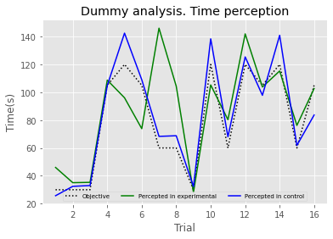
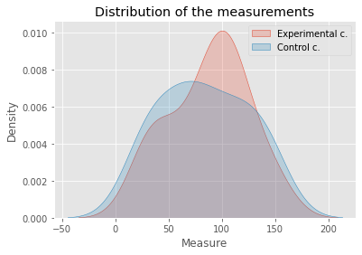
Summary of previous meeting
Explication of the psychopy experiment
Dummy/Quick analysis
Errors Repo: https://github.com/HazelPinto/TimePerceptionDemo

Slide 3
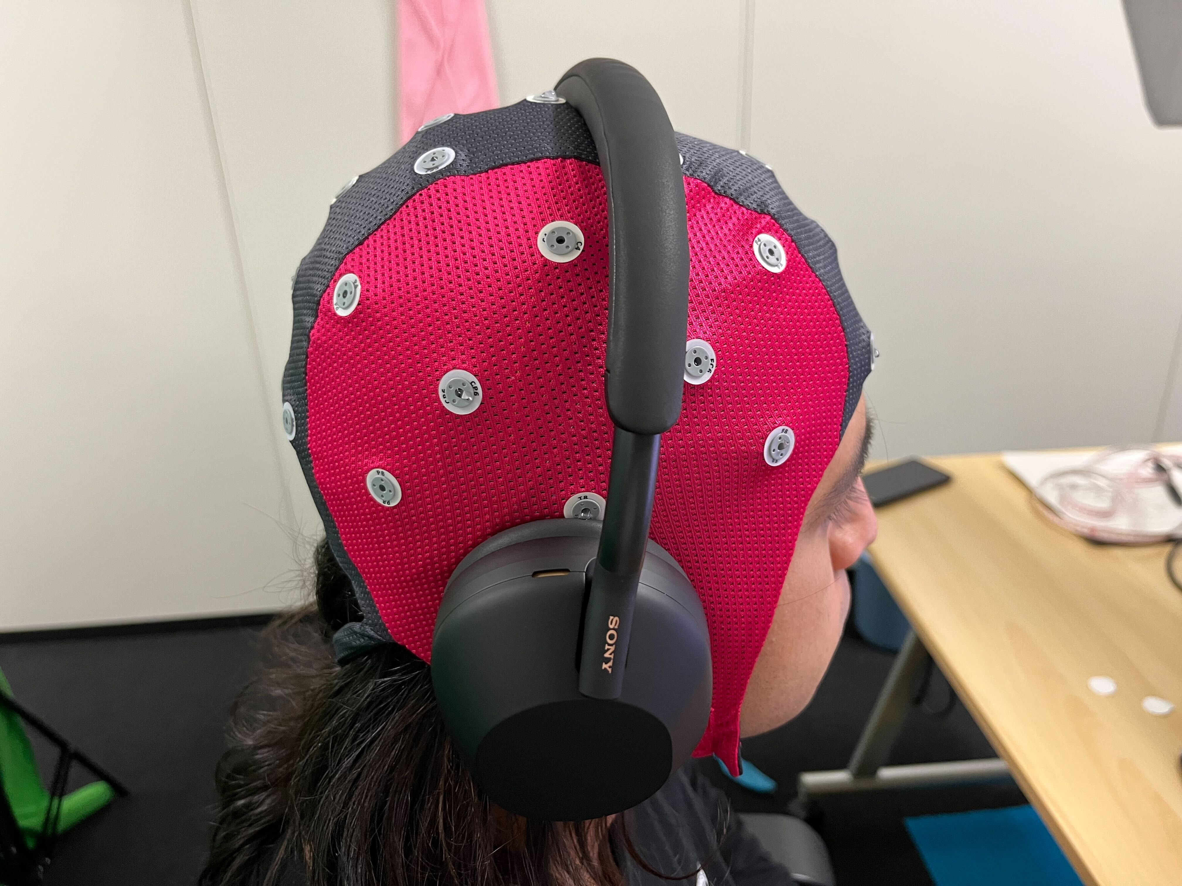
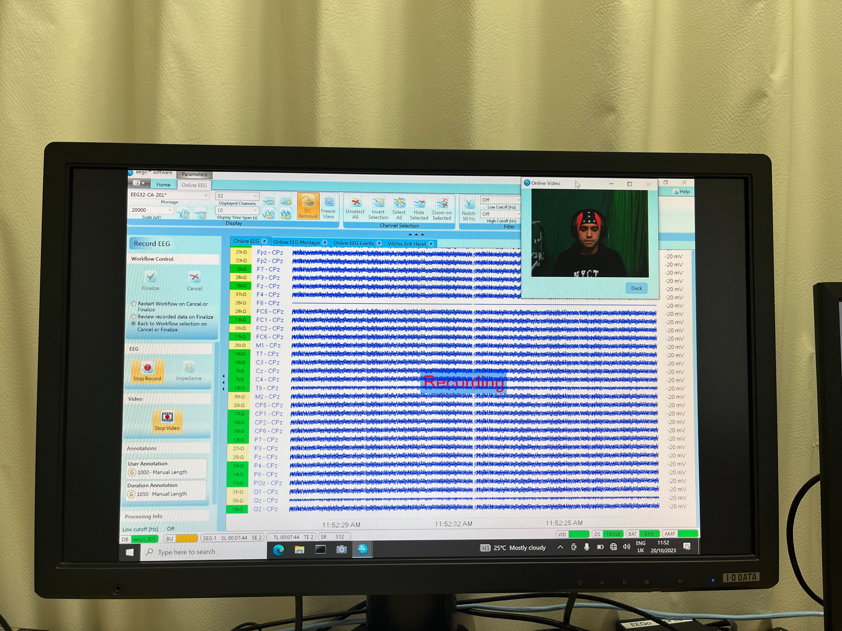
Summary of last two weeks
A)Fixing errors (the software stopped working at random points, triggers, etc.)
B) Inconcluded pilot
x31

Slide 4
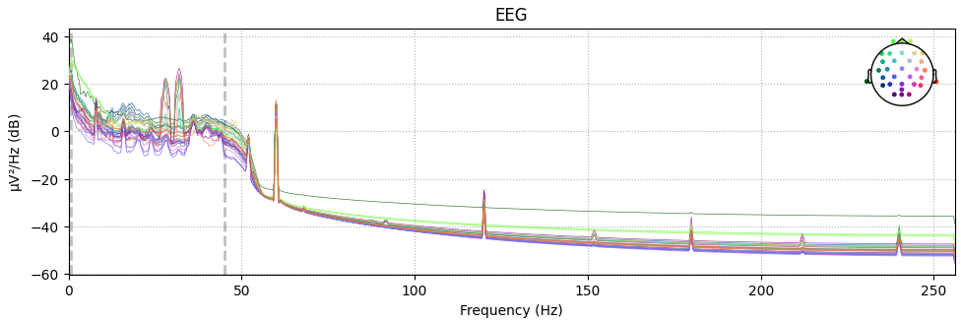
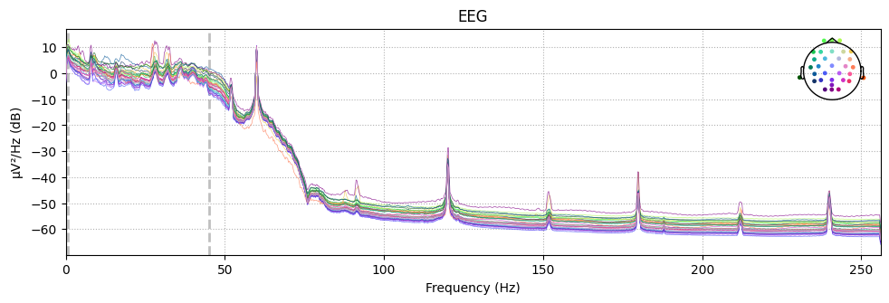
Summary of last two weeks
C) Cleaning and understanding the formats
Band-pass filter 0.8- 45Hz Plus ASR
Before After

Slide 5
Next task
Finishing Analysis and prove we can extract main features
Make a full session

Slide 6
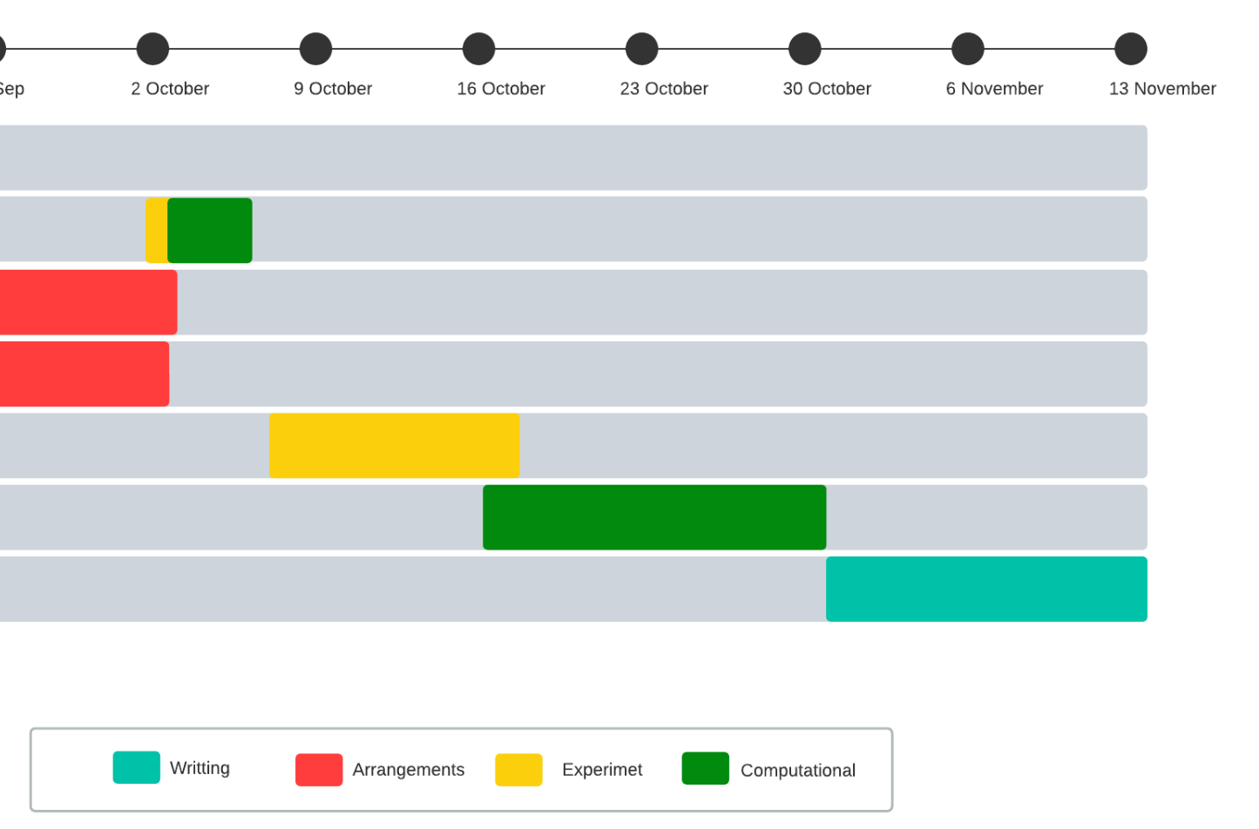
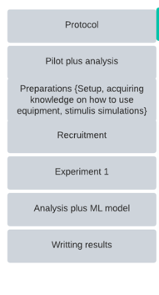
Future plan
Future plan
Content
Content

